Slide 1
Wildfire Intensity Data Analysis
CS 5525 Cloud Computing Project
Team Members:
Sindhusha Tiyyagura
Pradeepika Kolluru

Slide 2
Objective
The main objective of our project is to analyse NASA Fire data and to display the data in more sophisticated ways such as heat maps, bar graphs and linear graphs.
Notes:
NASA provides data for various things, from weather and climate to solar flares and wildfire.

Slide 3
Motivation
Million of users are being evacuated every year.
Avoid million acres of land being burnt
Can come up with the data patterns that help in predicting the future.
Notes:
NASA provides data for various things, from weather and climate to solar flares and wildfire.

Slide 4
Block Diagram:
Get Data
Analyse Data
Clean Data
Visualize
Splitting the data

Slide 5
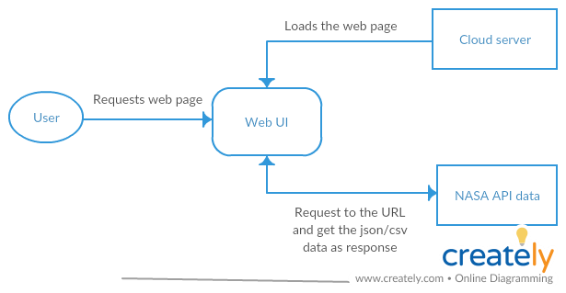
Architecture

Slide 6
Type of project:
Technologies used
Real time data using NASA FIRMS API
Angular 7 for creating web pages.
Open source visualization tools.
Github for tracking source code
Python and pycharm for developing models
Visualization and development

Slide 7
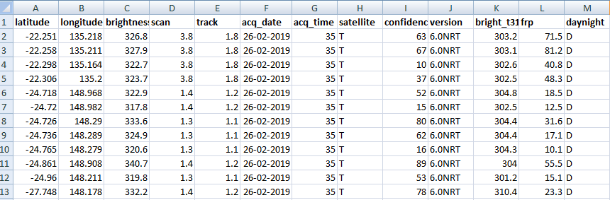
NASA FIRMS API
Gathering the real time fire data using NASA FIRMS API:
Notes:
FIRMS web service updates data every one hour. By default it gives past 1 day data. We can query for any time range. But of the time range is older than 7 days, we get archived which takes little more time to process.
These are params given by the API:
Generally it provides excel data for each region. It shows the temperature based on lat and lon ( one pixel point ) which is 1km range of data.

Slide 8
Expected Outcome
Creating Web User Interface:
Showing Heat maps.
Comparing the fire intensity across regions.
Comparing the changes in fire intensity in a particular region.
Dashboard which shows the regions with more fire intensity.
Notes:
These are the 3 things which we want to provide for the user.
Showing heat maps. Will provide user options to select the time period and user can select one point

Slide 9
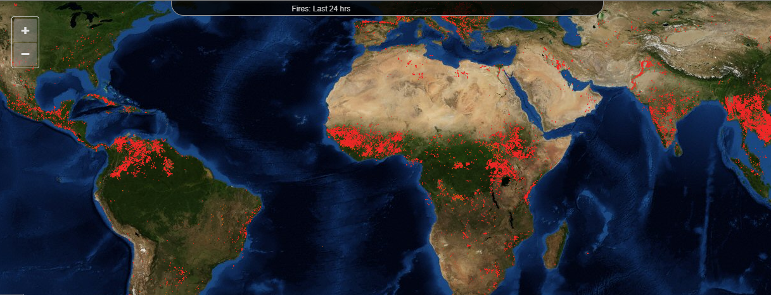
Notes:
Shows red coloring based on the fire intensity
It also shows details of the temp and scale of intensity based on the user hovered point or a region

Slide 10
Deploy
Deploying the web page on cloud server.

Slide 11
Future Work:
Using Machine Learning:
Predict where the next fire will Ignite?
Probability of wildfire spread across the region?
In this case, we will be writing python code for predicting the data.
Python code can be executed either by doing AJAX request or by creating a web service.

Slide 12
Learning:
Analysing Data
Using Visualization tools

Slide 13
Thank you

